Slide 1
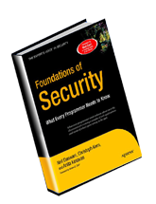
CHAPTER 1
Security Goals
Slides adapted from "Foundations of Security: What Every Programmer Needs To Know" by Neil Daswani, Christoph Kern, and Anita Kesavan (ISBN 1590597842; http://www.foundationsofsecurity.com). Except as otherwise noted, the content of this presentation is licensed under the Creative Commons 3.0 License.
Notes:
Welcome to SEC103 on Secure Programming Techniques. In this course, I assume that you have some background in computer security, but now you want to put that background to use. For example, in the Computer Security Principles and Introduction To Cryptography courses, we cover topics such concerning trust and encryption. In this course, we put these principles into to practice, and I’ll show you have to write secure code that builds security into your applications from the ground up.

Slide 2
Agenda
Seven Key Security Concepts:
  Authentication
  Authorization
  Confidentiality
  Data / Message Integrity
  Accountability
  Availability
  Non-Repudiation
System Example: Web Client-Server Interaction

Slide 3
1.1. Security Is Holistic
Physical Security
Technological Security
  Application Security
  Operating System Security
  Network Security
Policies & Procedures
All Three Required
Notes:
Physical Security:
Badges. Must be checked. No piggybacking to be nice.
Locks on doors. Screensavers with passwords.
Technological Security:
OS Security:
Encrypted file systems for laptops.
Application Security:
Web server has no vulnerabilities
Network Security:
No unauthorized packets are allowed into your network.
Policies and procedures:
Dumpster diving – use paper shredding
Guard against social engineering attacks (i.e., never tell your password to anyone, including a system administrator)
Technological Security
Policies and Procedures:
Guard against social engineering attacks.

Slide 4
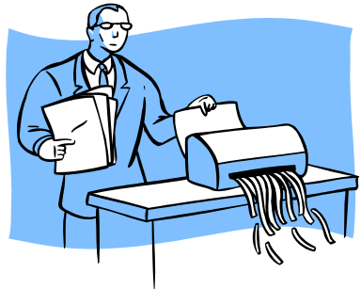
1.1.1. Physical Security
Limit access to physical space to prevent asset theft and unauthorized entry
Protecting against information leakage and document theft
Ex: Dumpster Diving - gathering
sensitive information by sifting
through the company’s garbage
Notes:
Physical Security:
Badges. Must be checked. No piggybacking to be nice.
Locks on doors. Screensavers with passwords.

Slide 5
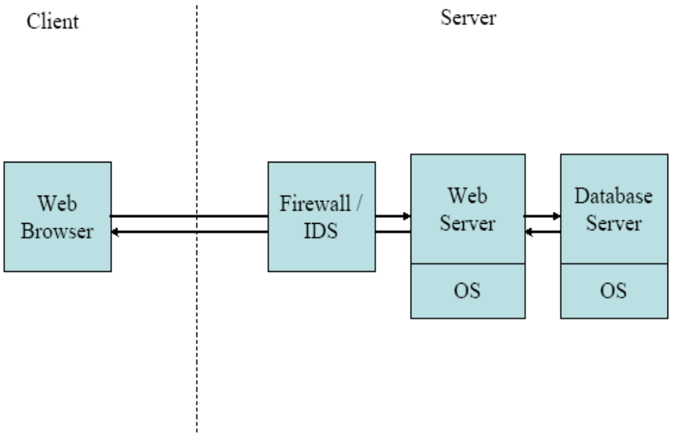
1.1.2. Technological Security (1) (Application Security)
No flaws in identity verification process
Configure server correctly
  local files
  database content
Interpret data robustly
Web Server & Browser Example

Slide 6
1.1.2. Technological Security (2) (OS & Network Security)
Apps (e.g. servers) use OS for many functions
OS code likely contains vulnerabilities
  Regularly download patches to eliminate
  (e.g. Windows Update for critical patches)
Network Security: mitigate malicious traffic
Tools: Firewalls & Intrusion Detection Systems

Slide 7
1.1.3. Policies & Procedures
Ex: Social engineering attack - taking advantage of unsuspecting employees (e.g. attacker gets employee to divulge his username & password)
Guard sensitive corporate information
Employees need to be aware, be educated to be somewhat paranoid and vigilant

Slide 8
Security Concepts
Authentication
Authorization
Confidentiality
Data / Message Integrity
Accountability
Availability
Non-Repudiation
Notes:
Will illustrate each of these concepts through running examples…

Slide 9


Archetypal Characters
Alice & Bob – “good guys”
Eve – a “passive” eavesdropper
Mallory – an “active” eavesdropper
Trent – trusted by Alice & Bob
Alice
Bob

Slide 10
1.2. Authentication
Identity Verification
How can Bob be sure that he is communicating with Alice?
Three General Ways:
  Something you know (i.e., Passwords)
  Something you have (i.e., Tokens)
  Something you are (i.e., Biometrics)
Notes:
(Phone call example… But what about email? Sender name could easily be “spoofed.”)
Will provide one example of each general “way” to achieve authentication, and will provide more details on all “ways” in the section of the course on common attacks and defenses.
Some security professionals distinguish between Identification and Authentication. Identification is the “public” part of the authentication process (entering username, or biometric scan). Authentication is the “private” part of the authentication process (entering password or PIN).

Slide 11
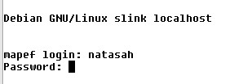
1.2.1. Something you KNOW
Example: Passwords
  Pros:
    Simple to implement
    Simple for users to understand
  Cons:
    Easy to crack (unless users choose strong ones)
    Passwords are reused many times
One-time Passwords (OTP): different password used each time, but it is difficult for user to remember all of them
Notes:
One-time-passwords can be used to address the second “con.”

Slide 12
1.2.2. Something you HAVE
OTP Cards (e.g. SecurID): generates new password each time user logs in
Smart Card: tamper-resistant, stores secret information, entered into a card-reader
Token / Key (i.e., iButton)
ATM Card
Strength of authentication depends on difficulty of forging
Notes:
Smart cards, ATM cards, and other tokens store “secrets.” (A “secret” is a sequence of bits, 0s and 1s, only know to the card/token and the system into which it is inserted.)

Slide 13

1.2.3. Something you ARE
Technique | Effectiveness | Acceptance
Palm Scan | 1 | 6
Iris Scan | 2 | 1
Retinal Scan | 3 | 7
Fingerprint | 4 | 5
Voice Id | 5 | 3
Facial Recognition | 6 | 4
Signature Dynamics | 7 | 2
Biometrics
Pros: “raises the bar”
Cons: false negatives/positives, social acceptance, key management
  false positive: authentic user rejected
  false negative: impostor accepted
Notes:
Iris scan: camera take picture of iris features
Retinal scan: beam of light projected into eye and scans retinal blood-vessel pattern. Eye put up to device, and puff of air blown into eye.
Signature dynamics: physical motions (pressure/speed) translated into characteristic electrical signals that re unique to the person writing signature.
Key management: user’s can’t get another thumbprint if their “key” is compromised!
Other Cons: people change over time (my face may not be exactly the same over ten years)
(See CISSP All-In-One page 131)

Slide 14
1.2.4. Final Notes
Two-factor Authentication: Methods can be combined (i.e. ATM card & PIN)
Who is authenticating who?
  Person-to-computer?
  Computer-to-computer?
Three types (e.g. SSL):
  Client Authentication: server verifies client’s id
  Server Authentication: client verifies server’s id
  Mutual Authentication (Client & Server)
Authenticated user is a “Principal”
Notes:
Methods can be combined: consider a typical ATM transaction. A user is authenticated based on something he/she HAS (the ATM card), and something he/she KNOWS (the PIN).
Also called “two-factor” authentication.

Slide 15

1.3. Authorization
Checking whether a user has permission to conduct some action
Identity vs. Authority
Is a “subject” (Alice) allowed to access an “object” (open a file)?
Access Control List: mechanism used by many operating systems to determine whether users are authorized to conduct different actions
Notes:
In the ATM example, authorization asks the question (once the user John Doe has been authenticated), “Does John Doe have permission to withdraw $200?” It depends on the amount of money that John Doe has in his bank account (must be >= $200), and the amount of money that John has already withdrawn earlier today (most ATMs let a user take out a maximum of $300 per day).
OSes use ACLs.
Capabilities are another mechanism that can be used to implement authorization. (See backup slides at end of course.)

Slide 16
1.3.1. Access Control Lists (ACLs)
Set of three-tuples
  <User, Resource, Privilege>
  Specifies which users are allowed to access which resources with which privileges
Privileges can be assigned based on roles (e.g. admin)
Table 1-1. A Simple ACL
User | Resource | Privilege
Alice | /home/Alice/* | Read, write, execute
Bob | /home/Bob /* | Read, write, execute
Notes:
Mandatory: System decides which users have access to which objects (i.e. Bell-LaPadula: Unclassified, Confidential, Secret, Top Secret with No Read Up and No Write Down)
Discretionary: Users decides who has access to objects they own
Role-Based: System decides which users can access which objects based on their *role*.

Slide 17
1.3.2. Access Control Models
ACLs used to implement these models
Mandatory: computer system decides exactly who has access to which resources
Discretionary (e.g. UNIX): users are authorized to determine which other users can access files or other resources that they create, use, or own
Role-Based (Non-Discretionary): user’s access & privileges determined by role

Slide 18
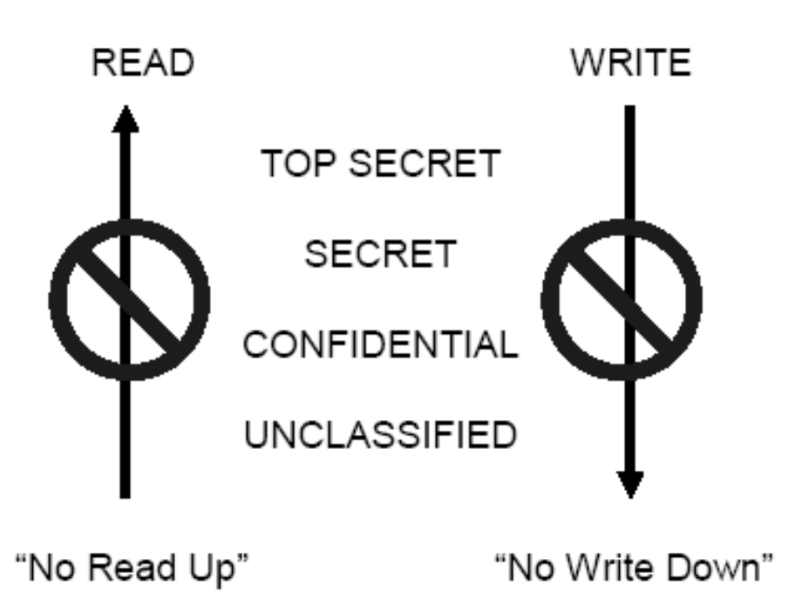
1.3.3. Bell-LaPadula Model
Classifications:
  Top Secret
  Secret
  Confidential
  Unclassified
3 Rules/Properties
  Simple property
  *-property
  (confinement)
  Tranquility property
Notes:
Basic Security Theorem: If the system starts in a secure state, and every state transition is secure, and the system will be secure after all transitions have been traversed.
Simple property: can’t read data at a higher level (no read up)
*-property: can’t write down (why? To prevent a Trojan horse executed by someone with a high classification to share data with a lower classification)
Tranquility: security level of an object can’t be changed while it is being used
Can be used to implement either mandatory or discretionary access control
See http://www.itsecurity.com/asktecs/apr3902.htm for more info

Slide 19
1.4. Confidentiality
Goal: Keep the contents of communication or data on storage secret
Example: Alice and Bob want their communications to be secret from Eve
Key – a secret shared between Alice & Bob
Sometimes accomplished with
  Cryptography, Steganography, Access Controls, Database Views
Notes:
Confidentiality can be achieved through some sort of encryption with a “key” but can be achieved through other mechanisms as well.

Slide 20
1.5. Message/Data Integrity
Data Integrity = No Corruption
Man in the middle attack: Has Mallory tampered with the message that Alice sends to Bob?
Integrity Check: Add redundancy to data/messages
Techniques:
  Hashing (MD5, SHA-1, …), Checksums (CRC…)
  Message Authentication Codes (MACs)
Different From Confidentiality:
  A -> B: “The value of x is 1” (not secret)
  A -> M -> B: “The value of x is 10000” (BAD)
  A -> M -> B: “The value of y is 1” (BAD)
Notes:
Downloading security software is another example that illustrates the difference between confidentiality and message/data integrity.
It is necessary to take distinct precautions to ensure data integrity even if communications are encrypted

Slide 21
1.6. Accountability
Able to determine the attacker or principal
Logging & Audit Trails
Requirements:
  Secure Timestamping (OS vs. Network)
  Data integrity in logs & audit trails, must not be able to change trails, or be able to detect changes to logs
  Otherwise attacker can cover their tracks
Notes:
Authentication + Signing in / out of a building creates accountability.
Audit trail: a stored sequence of commands that a user issues at a computer terminal.
Most existing logging/auditing security systems do not provide secure timestamping or data integrity – hence, an attacker can break into a system, and then change the logs to hid the fact that she was ever there!

Slide 22
1.7. Availability
Uptime, Free Storage
  Ex. Dial tone availability, System downtime limit, Web server response time
Solutions:
  Add redundancy to remove single point of failure
  Impose “limits” that legitimate users can use
Goal of DoS (Denial of Service) attacks are to reduce availability
  Malware used to send excessive traffic to victim site
  Overwhelmed servers can’t process legitimate traffic
Notes:
Why is Availability a Security Goal? Consider this extreme case: a computer that is turned off is extremely secure (no one can hack into it), but it is unavailable and unusable.

Slide 23
1.8. Non-Repudiation
Undeniability of a transaction
Alice wants to prove to Trent that she did communicate with Bob
Generate evidence / receipts (digitally signed statements)
Often not implemented in practice, credit-card companies become de facto third-party verifiers

Slide 24
1.9. Concepts at Work (1)
PCs-R-US
DVD-
Factory
B2B website
Bob
orders parts
Is DVD-Factory Secure?

Slide 25

1.9. Concepts at Work (2)
Availability:
  DVD-Factory ensures its web site is running 24-7
Authentication:
Confidentiality:
  Bob’s browser and DVD-Factory web server set up an encrypted connection (lock on bottom left of browser)
  Bob authenticates himself to DVD-Factory, Inc.
Encrypted Connection
  authenticates itself to Bob
Notes:
IS DVD-Factory Secure? This is actually a complicated question. Can break down and ask “Is DVD-Factory Available? Confidential? Etc”

Slide 26
1.9. Concepts at Work (3)
Authorization:
  DVD-Factory web site consults DB to check if Bob is authorized to order widgets on behalf of PCs-R-Us
Message / Data Integrity:
  Checksums are sent as part of each TCP/IP packets exchanged (+ SSL uses MACs)
Accountability:
  DVD-Factory logs that Bob placed an order for Sony DVD-R 1100
Non-Repudiation:
  Typically not provided w/ web sites since TTP req’d.

Slide 27
Summary
Technological Security In Context
Seven Key Security Concepts
DVD-Factory Example:
Security Concepts at Work

